Slide 1


Elo Merchant Category Recommendation
My first kaggle competition with big data experience
Competition Timeline
Start Date: November 26, 2018
End Date: February 26, 2019 11:59 PM UTC
Yunfei Bai

Slide 2

Context
Elo is one of the largest payment brands in Brazil.
Elo had built machine learning models to understand their customer but none of them is specifically tailored for an individual.
To develop algorithms to uncover signal in customer loyalty, helping Elo reduce unwanted campaigns and create right experience for customers.

Slide 3




Big data and tools
Where big data comes in:
Data is more than 3GB in total, more than 300K customers for over 30M transactions, can’t be read in python as a whole file in 8GB RAM PC.
Split into small chunks in order to upload into databrick.
Tools:
Databrick, Scala, Spark Mllib Pipeline, Spark XGBoost

Slide 4
Feature engineering
Merge all historical and new transactions
Build the pipeline to encoding categorical variables and generate final ensemble feature vector
Split the data into 70% to 30% for training and testing
Filled null data and transform date into numerical variables
Aggregate transactions into card holder level, and engineer out 19 numerical and 7 categorical features.

Slide 5
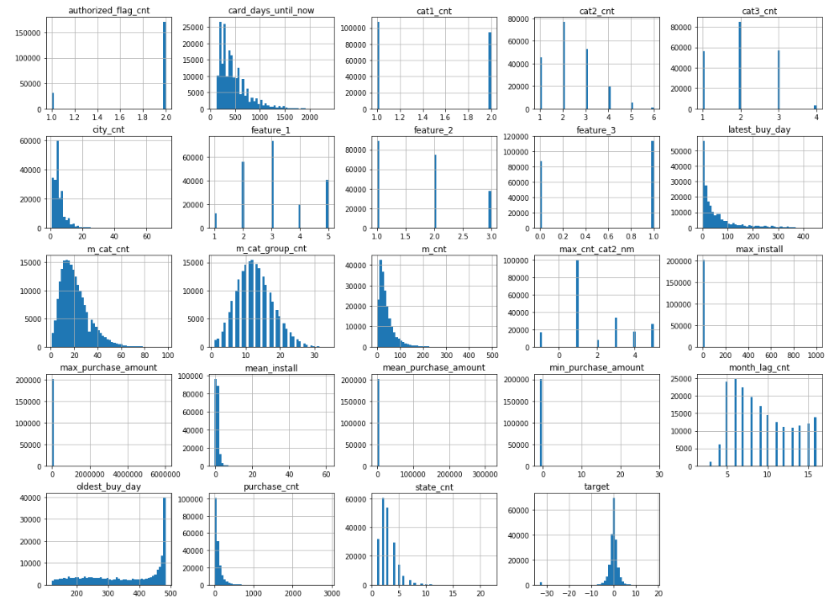
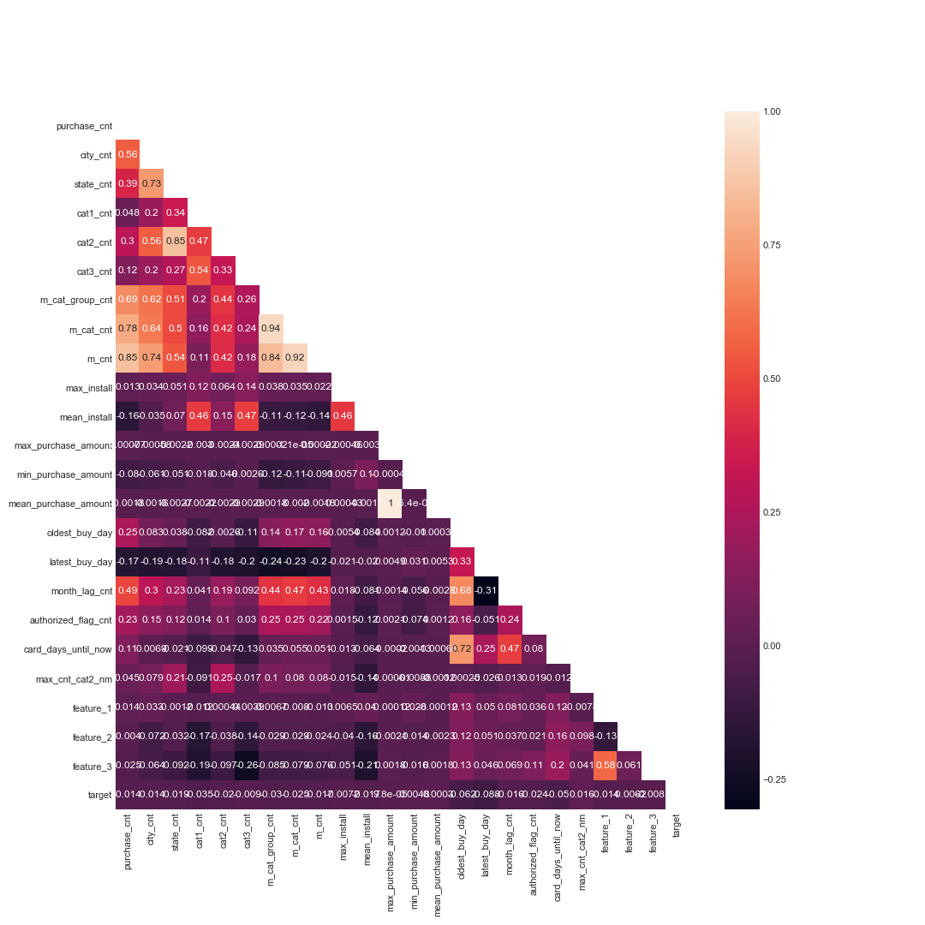
Data Exploration
Numerical features histogram:
Heatmap

Slide 6
Prediction
 | Linear Regression | Random Forest Regression | Gradient-boosted Tree Regression | XGBoost Tree Regression
Testing Scores | RMSE : 3.748 | RMSE : 3.699 | RMSE : 3.702 | RMSE : 3.778
LeaderBoard Submission Scores | RMSE : 3.900 | RMSE : 3.851 | RMSE : 3.838 | RMSE : 3.938
A
B
Radom Forest Regression wins in testing period
Gradient Boosting Regression wins in the submission step

Slide 7
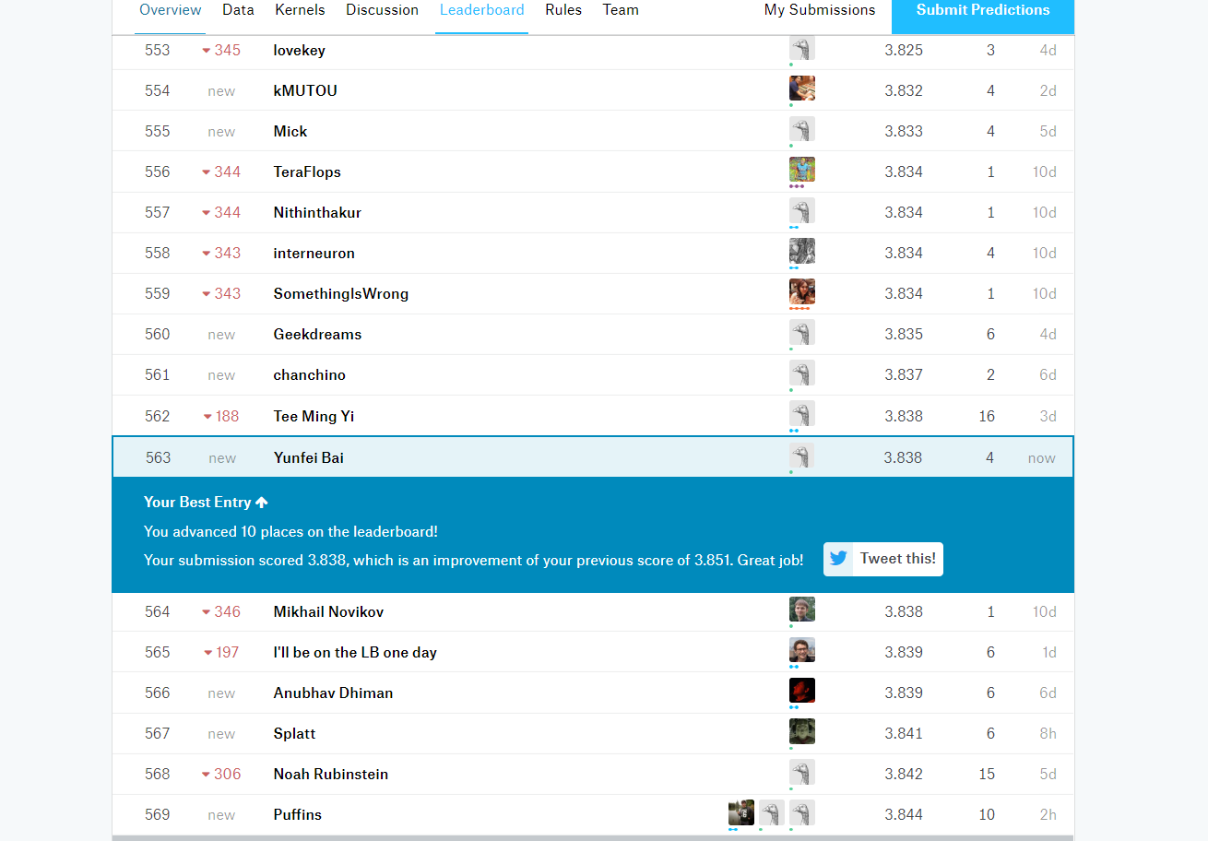
My current score and advice
My ranking: around 50%.
Advice: so far the best scores are coming from 5-Fold LightGB Model.

Slide 8
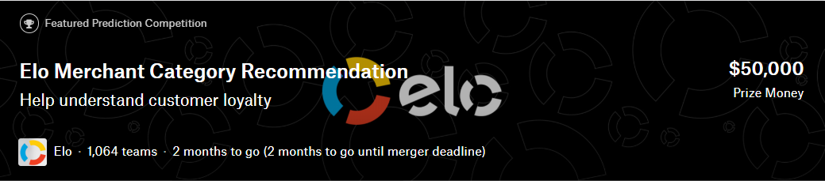
Good luck and have fun!
Databrick notebook:
https://databricks-prod-cloudfront.cloud.databricks.com/public/4027ec902e239c93eaaa8714f173bcfc/7792953078525217/2896759813459456/4057496721065160/latest.html
Github link: https://github.com/yunfeibai123/3252-Class-Project

